Slide 1
S-102 for data producers
IHO-MSDIWG10
Busan, Republic of Korea (4-5 March 2019)

Slide 2
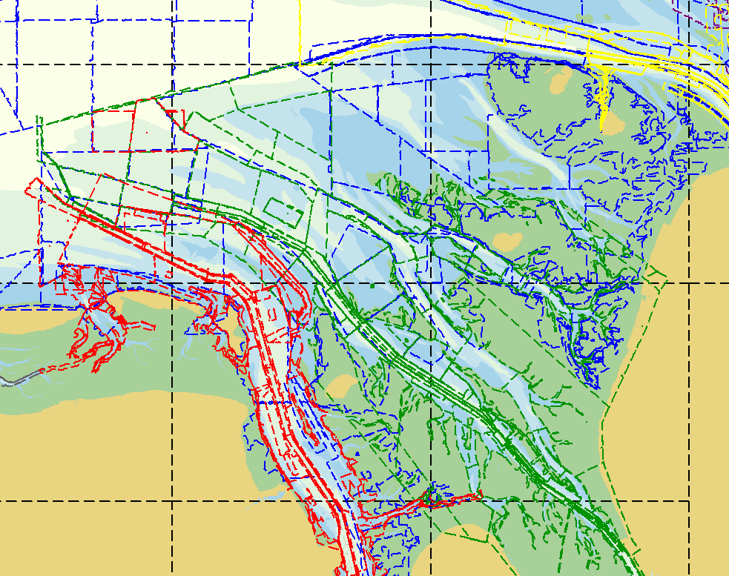
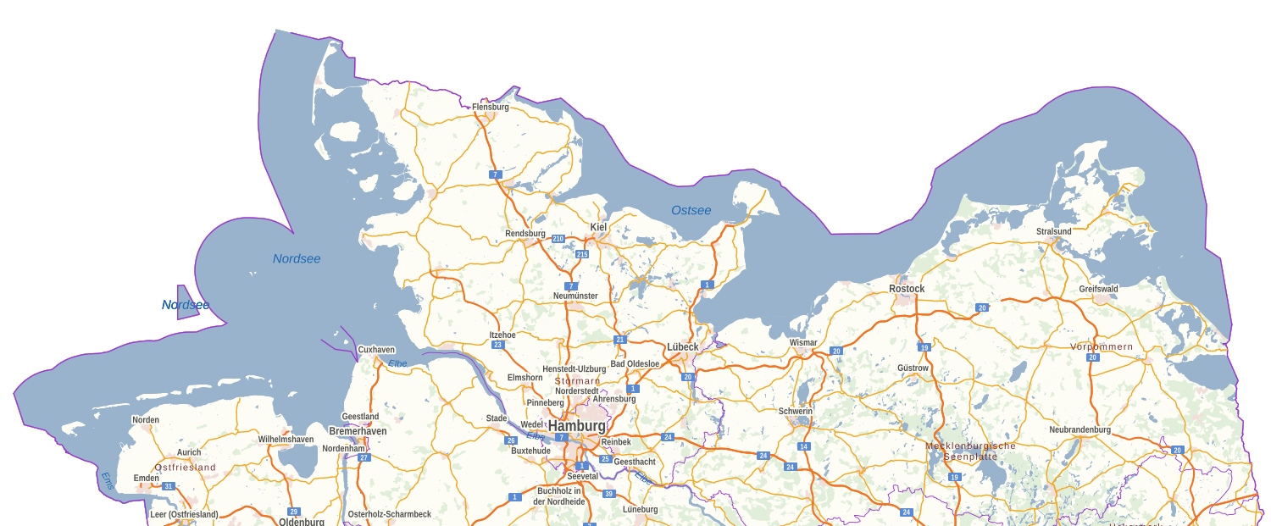
Data situation at BSH
Complete coverage with current data
Continuous and systematic surveys by different authorities
Different surveying methods (SBES, MBES, laser) depending on efficiency, terrain structure and political requirements
Surveying intervals depending on the dynamic of the sea area, e.g. nearly two-week rhythm in confined, highly frequented and rapidly changing waterways in the North Sea
2000 new surveying data sets per year, in the future 3000 estimated
6 different data providers
~ 850 blended surveying data sets
BALTIC SEA
Nearly unchanging sea area
Seaweed and silting areas
Stone fields
Confined and busy waterways
Uniform chart datum
NORTH SEA – German Bight
Very dynamic sea area
Tidal flats, strong tidal streams
Confined and busy waterways
Different chart datum

Slide 3
Marine Spatial Data Infrastructure
Policy & Governance (People)
Technical
Standards
(Standards)
Information Systems
(ICT)
Geographic Content
(Data)

Slide 4
Workflow at BSH
Pre-processing
Production
End-user
Error analysis and correction
Gridding
Plausibility checks
Grid-datasets
Metadata
Polygons
Inbox
bENCs
BSH surveying department
Tiling
Export of tiles
Generalizing of bathymetric surface
Converting to sounding datum
S-57
scale-dependent bathymetry
Blending
Navigational surface
Blended grid-datasets
Blended polygons with metadata
Bathymetric surface
Waterway and shipping
authorities
S-102
Navigational purpose
Compiling
Export
DTMs for other purposes
Harbour
authorities
S-102
combined with
S-104
Source-driven → Each source effects new product editions.
Tracking list → is not part of our current workflow.
Uncertainty → is a value which is used for data analyzing and correction.
Bathymetric surface ≠ Navigational surface
The metadata have to be carried from source to product.
Coastal protection authorities

Slide 5
S44 Matrix (PROPOSAL #1) Specifications for the Collection of Hydrographic Data (To be read in conjunction with the full text set out in this document.)
Properties |  |  |  |  |  |  |  | Reference |  | 1 | 2 | 3 | 4 | 5 | 6 | 7 | 8 | 9
Bathymetry (A)
THU (m) |  |  |  |  | AA |  | A | C2 H&V P C3-Depth |  | >50+010% of depth | 20+10% of depth | 10+10% of depth | 5+5% of depth | 2 | 1 | 0.5 | 0.1 | 0.05
TVU (m) |  |  |  |  | AB |  | B | C2 H&V P C3-Depth |  | a =5.0 b = 0.023 | a = 2.0 b = 0.023 | a = 1.0 b = 0.023 | a = 0.5 b = 0.013 | a = 0.25 b = 0.0075 | a = 0.25 b = 0.0075 | a = 0.15 b = 0.0075 | a = 0.10 b = 0.0075 | a = 0.05 b = 0.005
Seafloor Search Overlap between swath / line spacing |  |  |  |  | AC |  | C | C3-Depth |  | Not Required | >=5 x average depth | 4 x average depth | 3 x average depth or 25m (whichever is greater) | 100% Coverage (full seafloor coverage required) | 120% Coverage (10% overlap) | 150% Coverage (25% overlap) | 200% Coverage (50% overlap) | 400% Coverage (100% overlap)
Feature Detection Cubic features (edge size) |  |  |  |  | AD |  | D | C4 F NofB |  | Not Applicable | 10% of depth | Cubic feature > 2m | Cubic features > 2 metres, in depths up to 40 metres; 10% of depth beyond 40 metres | Cubic features > 1 metre | Cubic features > 0.5 metre | Cubic features > 0.3 metre | Cubic features > 0.1 metre | Cubic features > 0.05 metre
Navigational Aids, Structural and Topographic Features (B)
Total Horizontal Uncertainty (THU)
Positioning of Fixed Aids (m), |  |  |  |  |  | BA | E |  | C-6 Topo | >20 | 20 | 10 | 5 | 2 | 1.0 | 0.5 | 0.1 | 0.05

Slide 6
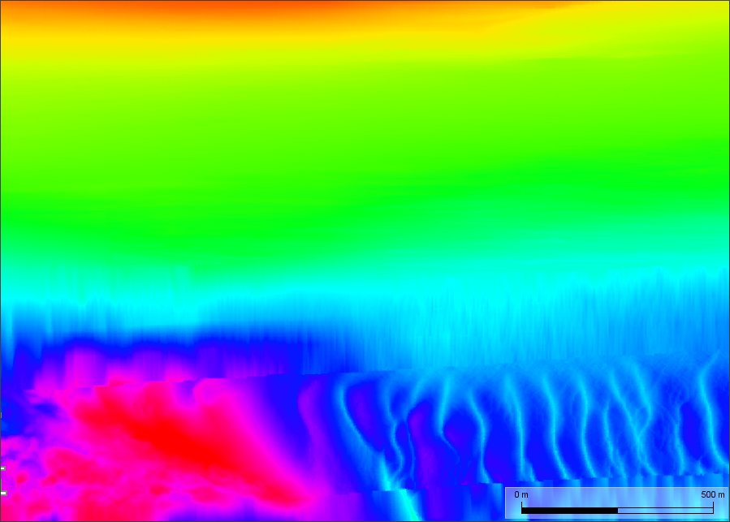
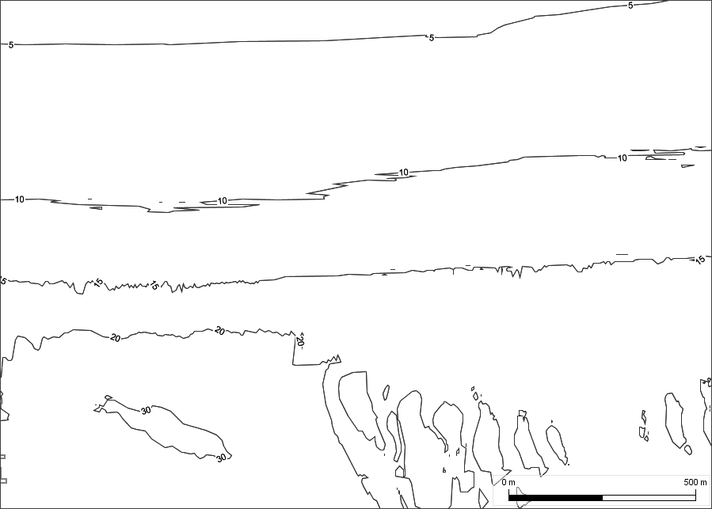
Bathymetric Surface & Contours

Slide 7
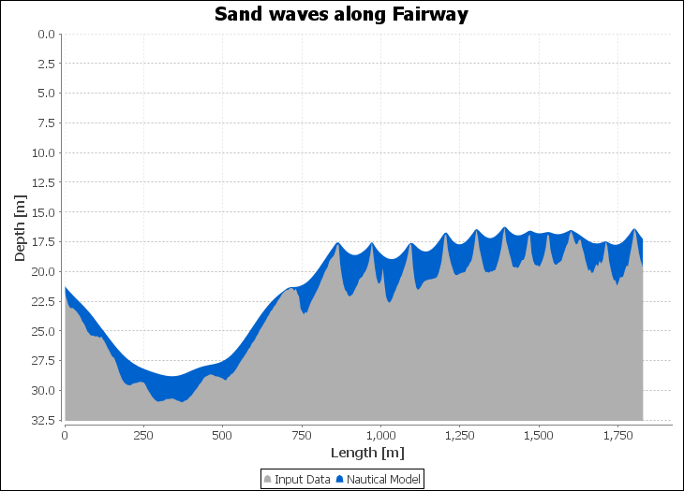
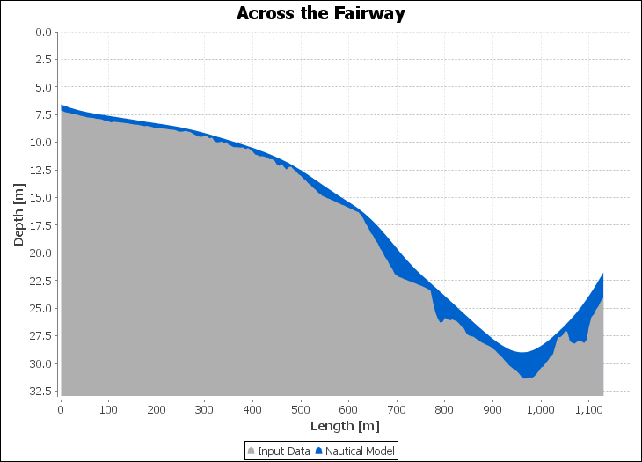
Bathymetric & Navigational Surface

Slide 8
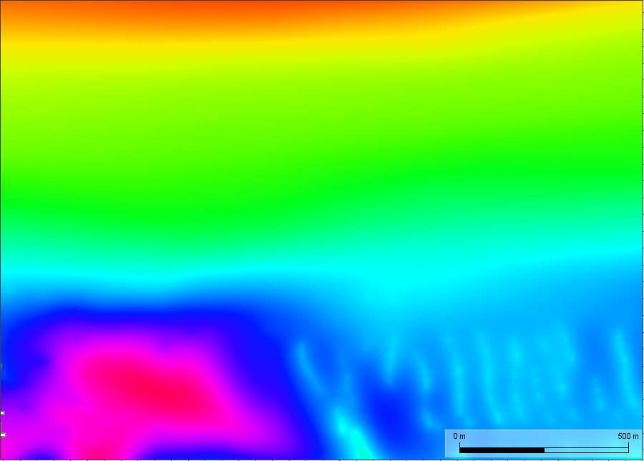
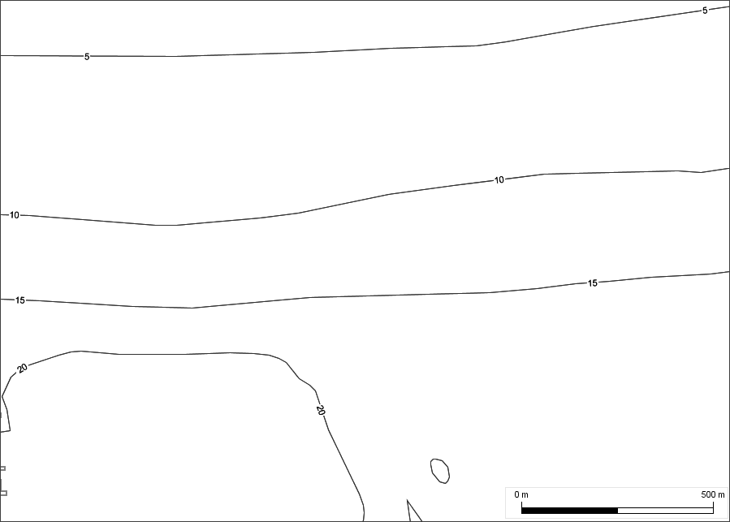
Navigational Surface & Contours

Slide 9
BSH comments
For the production of harmonized S-102 data products that can be used in IMO defined e-Navigation systems we need
a common understanding of terms and definitions,
common requirements for a safe navigation,
a clear separation between data capturing, data processing aspects and end-user aspects

Slide 10
Conclusions
The production of bathymetric datasets comprises a complex workflow with many individual steps from data capturing via data analyzing, data processing up to data providing depending on:
characteristics of the sea area
current data situation
capacities and technical pre-conditions
organizational structure of a Hydro-graphic Office
national requirements
The requirements for a safe navigation result from the interoperable use of ENC as basis and the S-102 data product as well as the needs for high-resolution bathymetric data of mariners.
Real challenge
Easy part
In a S-102 PS we should consider the diversity of approaches
and the uniform requirements for a safe navigation.

Slide 11
Conclusions
Uncertainty
The uncertainty could serve as a basis for the derivation of data quality.
It is not compatible yet with the metadata in an ENC.
The data structure for the purpose of safe navigation should only comprise the necessary information for the mariner but not all information which we use during the production process or for other purposes.
Tracking list
We see the tracking list with its current meaning as a special and optional component of a national workflow.
It could have a benefit for the mariner if we use it e.g. as coverage for the least depth over significant and classified features (under water obstructions).
Bathymetric surface vs. navigational surface
We should find a clear and general definition for both terms.

Slide 12
Questions for discussion at S102 PT
Which information are really relevant for the mariner and a safe navigation? (Mariners trust the data on the screen.)
How can we limit the data structure to the minimum required for navigation in order to reduce data volume and information overload on board?
What do we need to make the S-102 and S-101 interoperable?
Which terms have to be necessarily reviewed for a common understanding?
How can we design the next S-102 in order to make a clear distinction between the production components and the components for a safe navigation?

Slide 13
Questions for discussion
Policy & Governance (People)
Technical
Standards
(Standards)
Information Systems
(ICT)
Geographic Content
(Data)
Policy & Governance (People)
Information System (ICT)
Technical Standards (Standard)
Geographic Content (Data)
Process (Network)

Slide 14
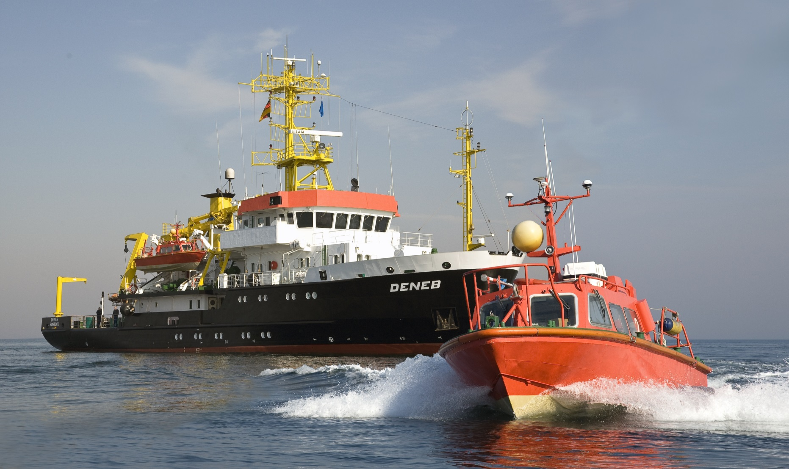
Thank you!

